Slide 1


Skeletal System
Dr. Mahdi H. Hammadi
PhD Sc. Clinical Physiology

Slide 2
Skeletal System

Slide 3
Bones of the Axial Skeleton
The Axial Skeleton is the central core of the human body housing and protecting its vital organs.

Slide 4
The axial skeleton consists of 80 bones:
29 bones in the head - (8 cranial and 14 facial bones) and then also 7 accociated bones (6 auditory ossicles and the Hyoid Bone)
25 bones of the thorax - (the sternum and 24 ribs)
26 bones in the vertebral column (24 vertebrae, the sacrum and the coccyx)

Slide 5
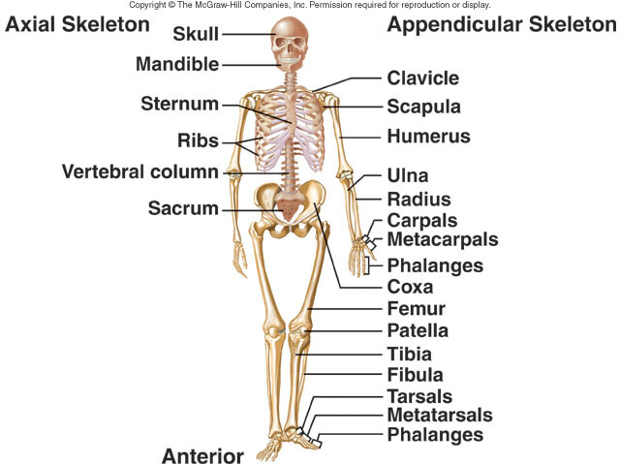

Slide 6
The function of the Axial skeleton
The Axial Skeleton has 2 functions.
1- Support and protect the organs in the dorsal and ventral cavities.
2- It creates a surface for the attachment of muscles.

Slide 7
Bones of the Appendicular skeleton:
4 bones in the shoulder girdle (clavicle and scapula each side)
6 bones in the arm and forearm (humerus,ulna and radius)
58 bones in the hands (carpals 16, metacarpals 10, phalanges 28 and sesamoid 4)
2 pelvis bones
8 bones in the legs (femur, tibia, patella and fibula)
56 bones in the feet (tarsals, metatarsals , phalanges and sesamoid)

Slide 8
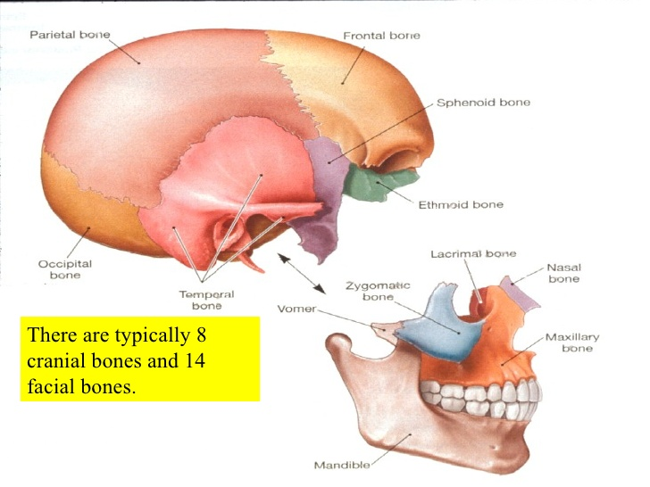
Bones of the Skull (cranial bones and facial bones):

Slide 9
The Cranial bone including (8 bones):
The Sphenoid Bone
The Ethmoid Bone
The Frontal Bone
The Occipital Bone
The Temporal Bone
The Parietal Bone

Slide 10
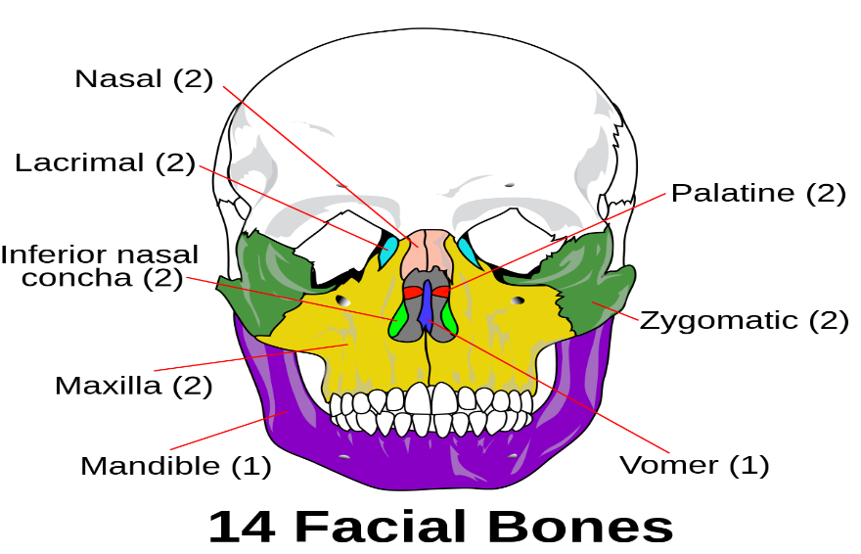
The facial bones (14)

Slide 11
  The nasal bones (2)
  The maxillae (upper jaw) (2)
  The lacrimal bone (2)
  The zygomatic bone or cheekbone (2);
  The palatine bone (2)
  The inferior nasal concha (2)
  The vomer
  The mandible (lower jaw)

Slide 12
The hyoid bone (not connected to any other bone)
The hyoid is a small, U-shaped bone found just inferior to the mandible. The hyoid is the only bone in the body that does not form a joint with any other bone.

Slide 13
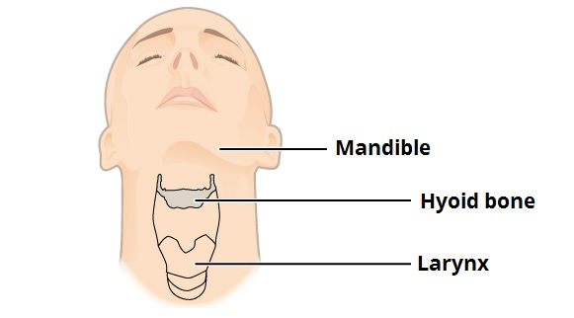

Slide 14
In the middle ears (6) :
  malleus (2)
  incus (2)
  stapes (2)

Slide 15
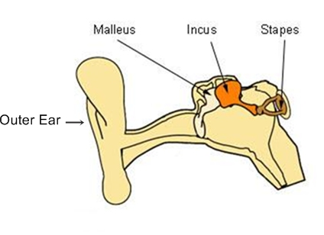

Slide 16
The Ribs (or Costas) and The Sternum (or Breast Bone) The rib cage, or thoracic cage, is a bony/cartilaginous structure surrounding the thoracic cavity and supporting the pectoral girdle. A typical human rib cage consists of 24 ribs : sternum costal cartilages, 12 thoracic vertebrae making up the thoracic wall and providing attachments for muscles (neck, thorax, upper abdomen, and back). All ribs are attached in the back to the thoracic vertebrae. | How many ribs do humans have? 12 pair, or 24 total ribs

Slide 17
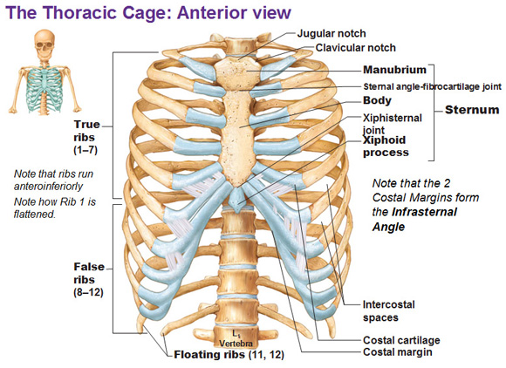

Slide 18
True Ribs, or Vertebrosternal Ribs, or 1-7 — are attached to the
sternum by costal cartilage,
False Ribs, or Vertebrochondral Ribs, or 8-10 — join with the costal cartilages of the true ribs
Floating Ribs, or Vertebral Ribs, or 11 and 12 — do not have any anterior connection to the sternum
Costal Cartilage — bars of hyaline cartilage which serve to prol

Slide 19
Vertebrae Column:
Twenty-six vertebrae form the vertebral column of the human body. They are named by region:

Slide 20
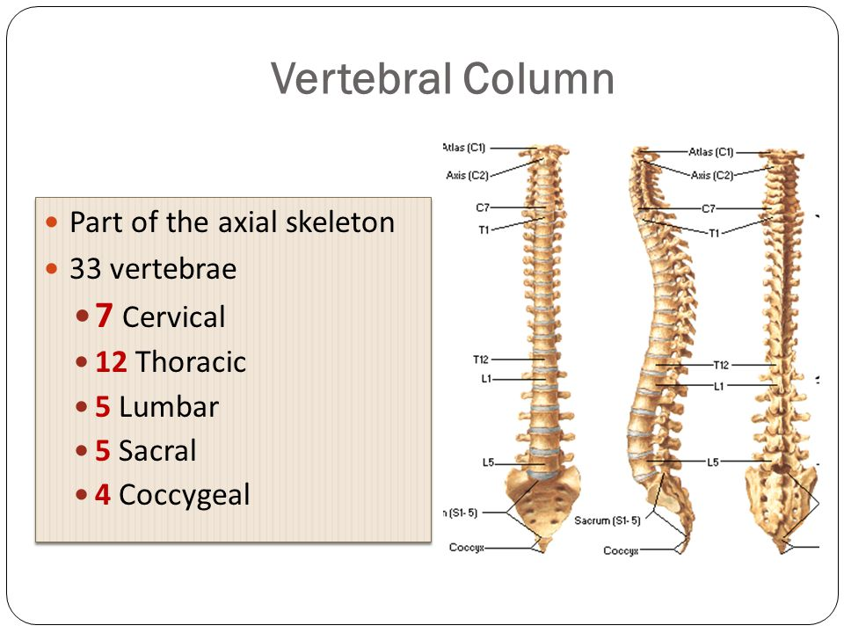

Slide 21
Cervical (neck) - 7 vertebrae
Thoracic (chest) - 12 vertebrae
Lumbar (lower back) - 5 vertebrae
Sacrum - 1 vertebra
Coccyx (tailbone) - 1 vertebra

Slide 22
